Slide 1
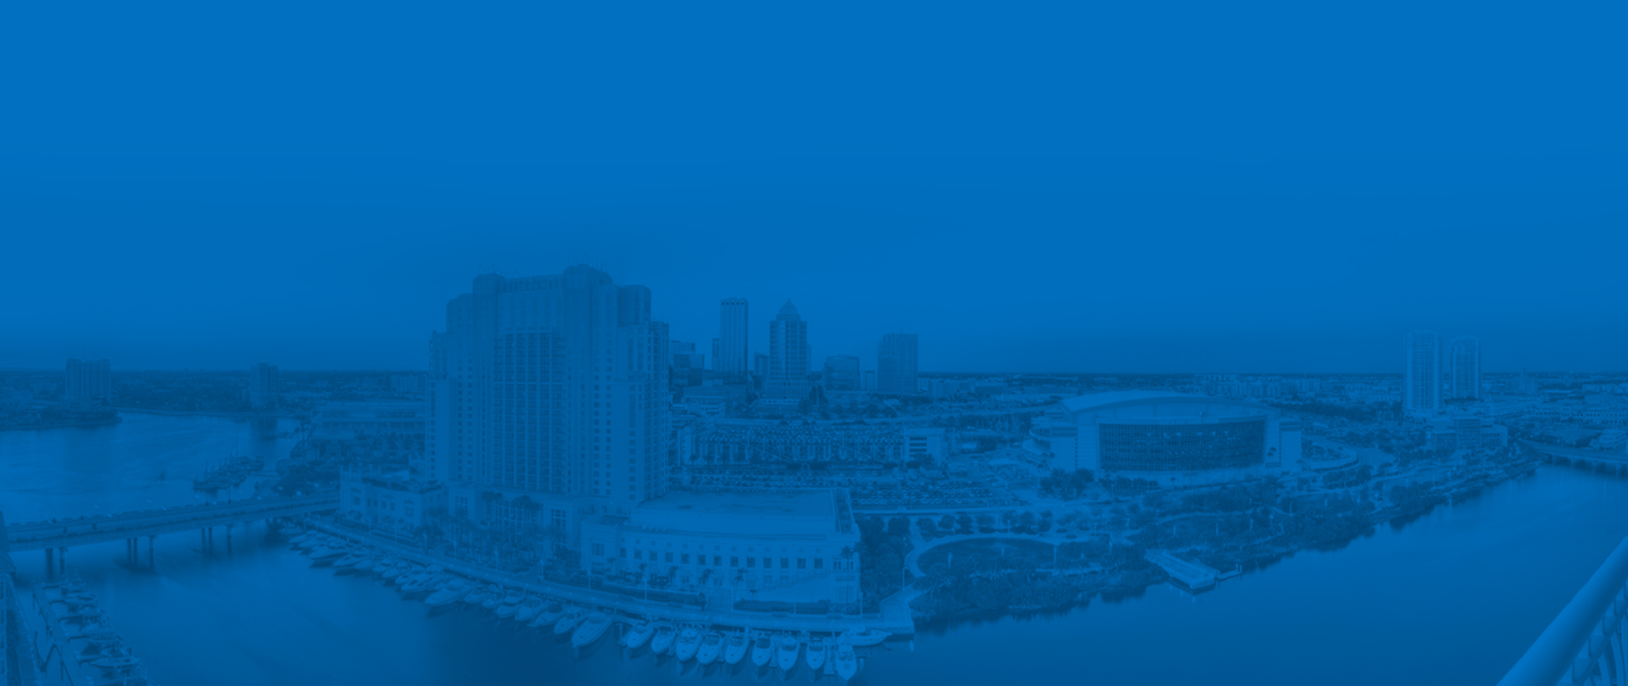

Update on Downtown Projects
Public Meeting
April 25, 2019

Slide 2

Agenda
Overview
Current and Future Project Detail
  Old Water Street
  TECO Conduit Relocation
  Old Water Crosswalk
  Knights Run
  Emergency Bypass on Harbour Island Bridge
  TECO Conduit Whiting-Jefferson St. Construction and Other Future Work
Pedestrian Crosswalk Enhancements
Harbour Island Force Main Design-Build Replacement Project
Communication with the Public
Harbour Island Complete Streets
Questions

Slide 3
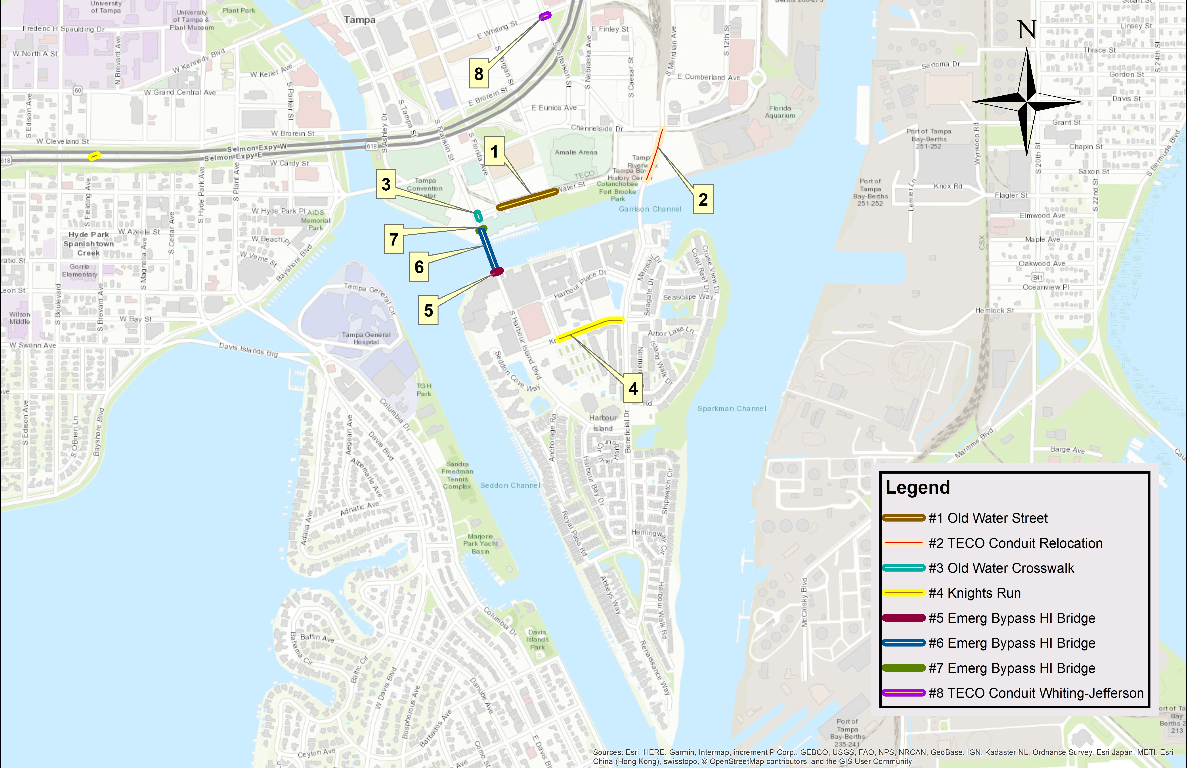
Overview

Slide 4
Old Water Street (1)
We will shut down all eastbound movement on Old Water from Florida Avenue from 4/29/19 to 8/19/19
The roadway will be closed from Florida to Morgan in all directions.

Slide 5
TECO Manhole/Conduit Relocation (2)
  Work to begin in mid-April
  Will require the closure of one south bound lane on Beneficial from Channelside to the Tampa Bay History Center
  Work will conclude at the end of July 2019

Slide 6
Old Water Crosswalk (3)
  This work will be scheduled for a time period after we complete the TECO work on Beneficial so as to avoid major impacts to traffic on both bridges at the same time. We will give you several weeks notice before the work starts.

Slide 7
Knights Run (4)
Installation of 12-inch force main will be coordinated with upcoming complete streets project on Knights Run Avenue and Beneficial Drive
City is expediting design and construction of 12-inch force main
Construction estimated to start in early 2020

Slide 8
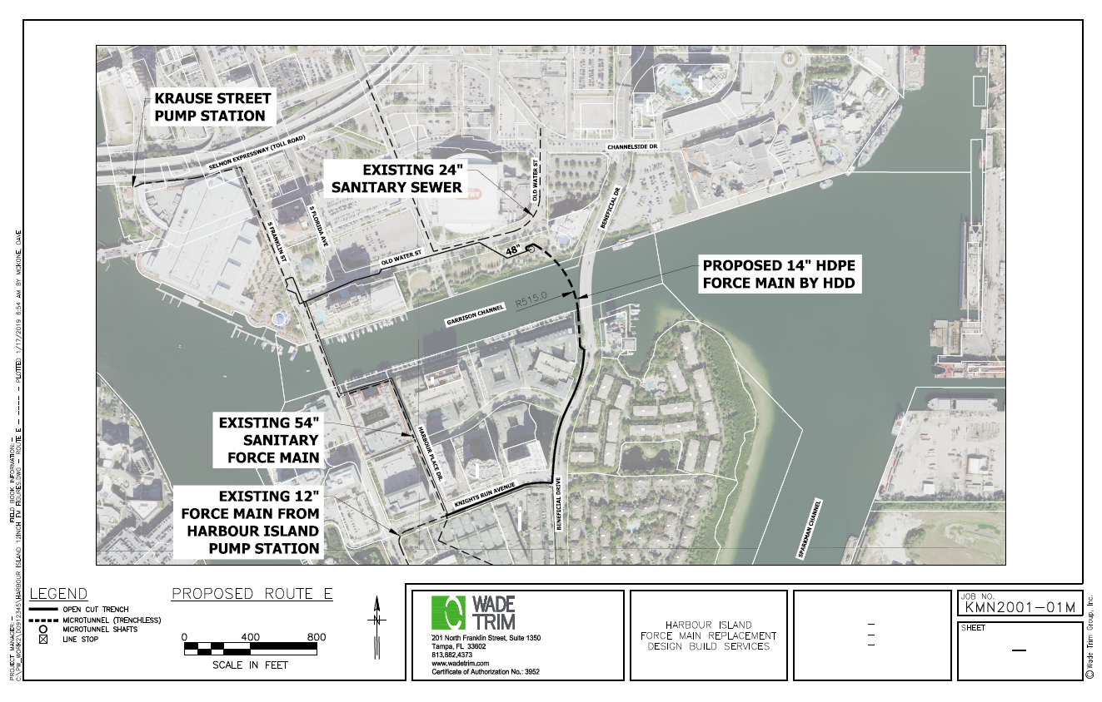
Proposed 12” Force Main Route

Slide 9
Pipeline Rehabilitation &
Bypass Installation (5, 6, & 7)
Approximately 600 linear feet of line will need to be rehabilitated with carbon lining
Will require the installation of a bypass system
Work to started in March and be completed in July 2019.
The Bypass work is currently underway and we anticipate it being done by 5/10/19 and the bypass being in operation the following week.
The cranes and barges you see around the Convention Center as associated with this work.

Slide 10
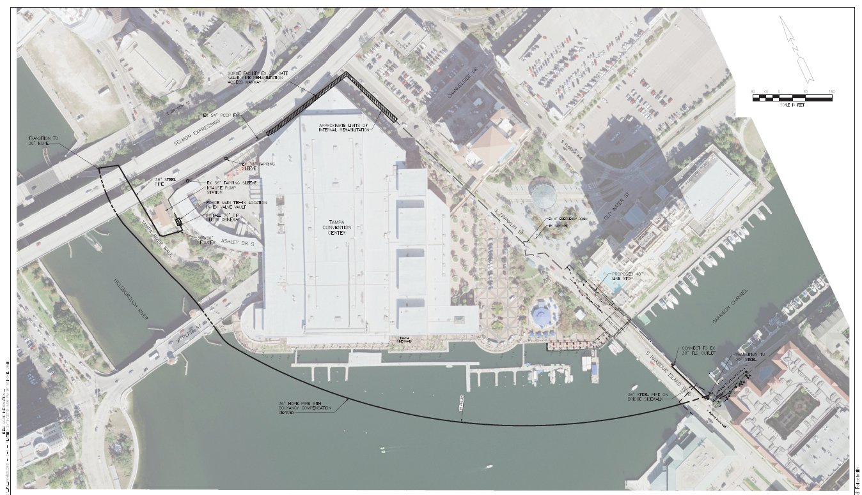
Pipeline Rehabilitation &
Bypass Installation Route

Slide 11
Pipeline Rehabilitation & Bypass Impacts
to Harbour Island Bridge
Bypass piping will need to be installed on the Harbour Island Bridge along the east side sidewalk. Work to start in mid to late April.
Installation of piping will require temporary closure of the east side sidewalk and the north bound lane during off peak hours for the durations noted below:
    South Connection Point: 2 days
    Bypass Piping: 10 days
    Reset Linestop 3 days
The north bound lanes will remain open after installation and during rehabilitation work. The sidewalk along the east side of the bridge will remain closed due to the final piping configuration.
After completion of rehabilitation work (estimated in late June), bypass piping will be removed which will impact the north bound lane during off-peak hours. Duration will be coordinated closer to start date.

Slide 12
TECO Conduit – Whiting-Jefferson (8)
This work consists of installing conduits for TECO across Jefferson at the Whiting Street intersection.
This work will occur this summer and last 20 days

Slide 13
Project Schedule
DESCRIPTION | 2019
 | APRIL |  |  |  |  | MAY |  |  |  | JUNE |  |  |  | JULY |  |  |  |  | AUG |  |  |  | SEPT |  |  |  |  | OCT
 | 01 | 08 | 15 | 22 | 29 | 06 | 13 | 20 | 27 | 03 | 10 | 17 | 24 | 01 | 08 | 15 | 22 | 29 | 05 | 12 | 19 | 26 | 02 | 09 | 16 | 23 | 30 | 07 | 14 | 21 | 28
Force Main on Old Water Street #1
TECO Conduit on Beneficial Relocation #2
Old Water Improvements at Franklin Street #3
12” Force Main Relocation on Knights Run #4
Emergency Bypass Work on HI Bridge #5
Emergency Bypass HI Bridge Pipe on Bridge #6
Emergency Bypass HI Bridge North Linestop #7
HI Bridge Sidewalk Closure (#5,6,7)
TECO Conduit Crossing at Whiting/Jefferson #8

Slide 14
Project Schedule
DESCRIPTION | 2020
 | OCT |  |  |  |  | NOV |  |  |  | DEC |  |  |  | JAN |  |  |  |  | FEB |  |  |  | MARCH |  |  |  |  | APRIL
 | 30 | 07 | 14 | 21 | 28 | 04 | 11 | 18 | 25 | 02 | 09 | 16 | 23 | 30 | 06 | 13 | 20 | 27 | 03 | 10 | 17 | 24 | 02 | 09 | 16 | 23 | 30 | 06 | 13 | 20 | 27
Force Main on Old Water Street #1
TECO Conduit on Beneficial Relocation #2
Old Water Improvements at Franklin Street #3
12” Force Main Relocation on Knights Run #4
Emergency Bypass Work on HI Bridge #5
Emergency Bypass HI Bridge Pipe on Bridge #6
Emergency Bypass HI Bridge North Linestop #7
TECO Conduit Crossing at Whiting/Jefferson #8

Slide 15
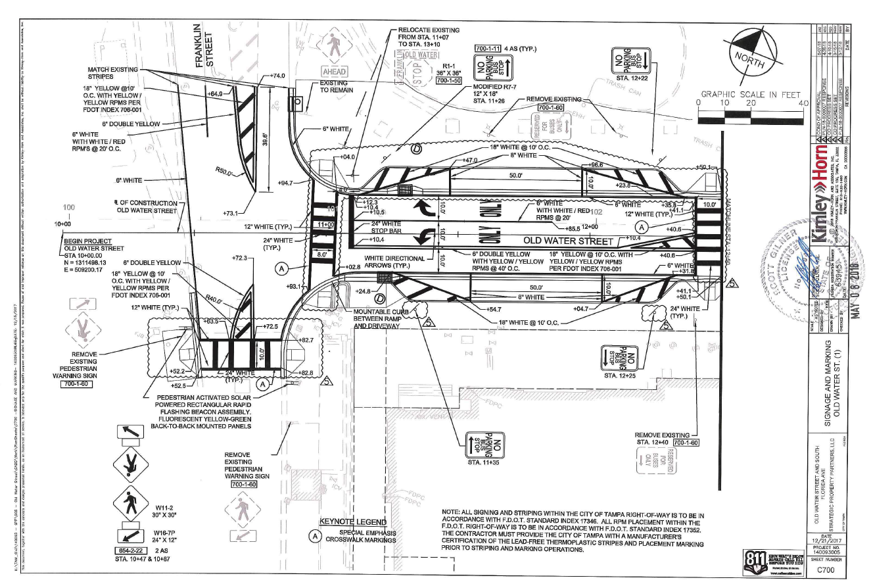
Pedestrian Crosswalk Enhancements

Slide 16
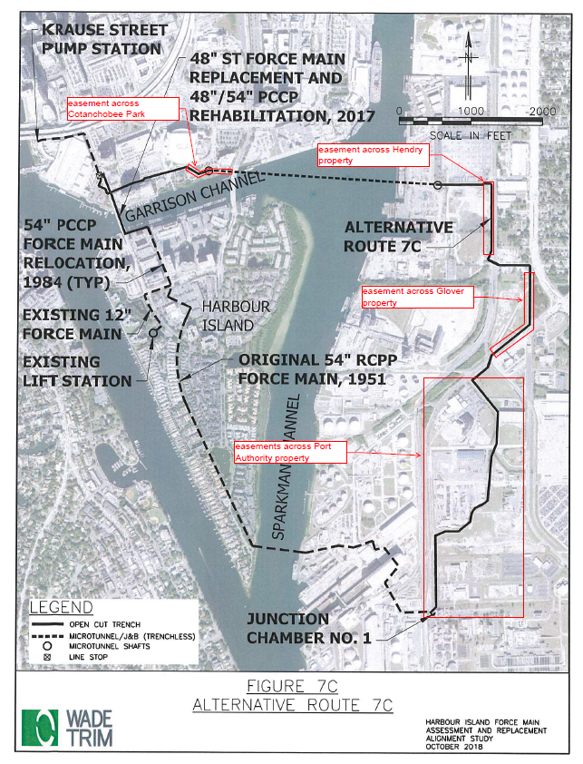
Harbour Island Force Main
Preferred 48”/54” Force Main Route
Received easement approval from Port Tampa Bay
Still awaiting easement approval:
  Hendry and Glover properties are agreeable to the easements and appraisals are in the process of being performed
  Easement across Cotanchobee Park requires approval by Florida Communities Trust – the request is under consideration

Slide 17
Harbour Island Force Main
Final Route recommendations to the City by May 2019
First Segment of Harbour Island Force Main Installation (along Water Street) began in mid-December 2018. Scheduled to be completed by August 2019
Proposed 12” Force Main
  Design scope and approval of contract amendment is approved and work is underway
  Design and development of construction contract estimated to be completed by October-November 2019.
  Construction will likely start in early 2020 and will last approximately 3-4 months
Final 48”/54” Force Main route design
  Design scope and contract amendment to be developed after approval of route selection. Route is determined and just are awaiting final approval of easements across two private landowners.
  Design will take approximately 1 year

Slide 18
Communication with the Public
Harbour Island Force Main Project Website
  www.hiforcemain.com
Harbour Island Force Main Project Hotline
  (813) 235-4830
Harbour Island Community Task Force
Transportation Advisories and Road Closures
  https://www.tampagov.net/news-transportation-advisories-road-closures

Slide 19

HARBOUR ISLAND COMPLETE STREETS –
City Project #1001162
Cal Hardie, P.E., Capital Projects Engineer
City of Tampa Transportation and Stormwater Services Dept.

Slide 20
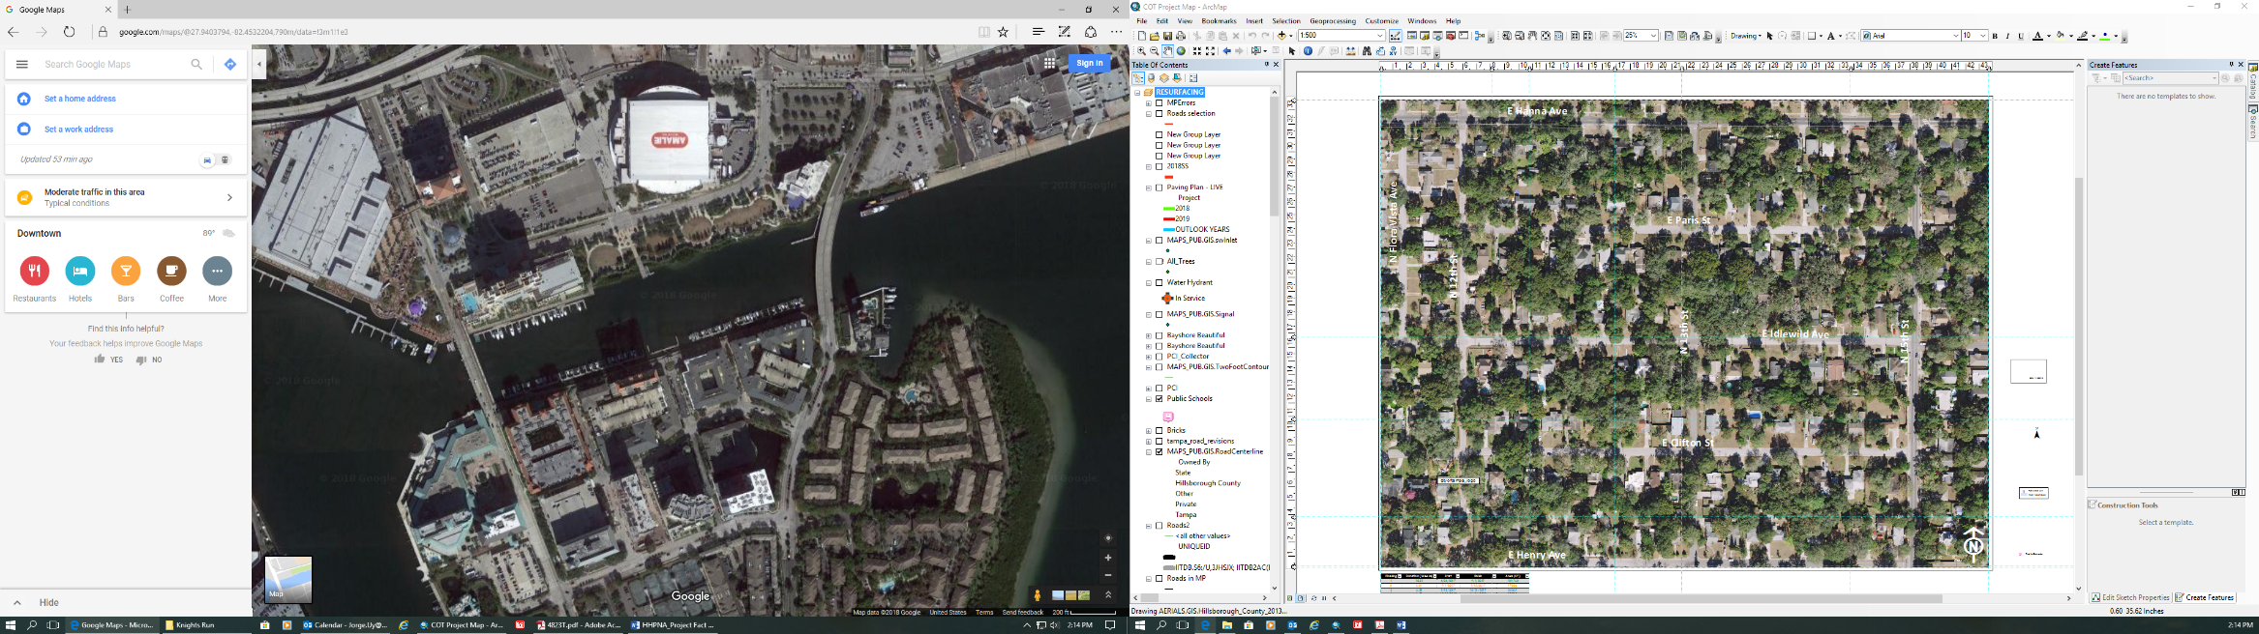
PROJECT TEAM
Transportation and Stormwater Services Transportation Division
Jean Duncan, P.E., Director
Cal Hardie, P.E., Capital Projects Manager
Jorge Uy, P.E., City Pavement Management Engineer
Bernadette Corey, Project Manager
Knights Run Ave and Beneficial Dr

Slide 21
WHAT IS THIS PROJECT?
What it is… | What it isn’t…
Rehabilitates the pavement Calms traffic by narrowing lanes and lowering posted limit Provides for multi-modal transportation by installing bike lanes. Install multiple raised pedestrian crosswalks to make the area safer for pedestrians. | This is not a project to install sidewalks. This is not related to the Wastewater Pipeline project.

Slide 22
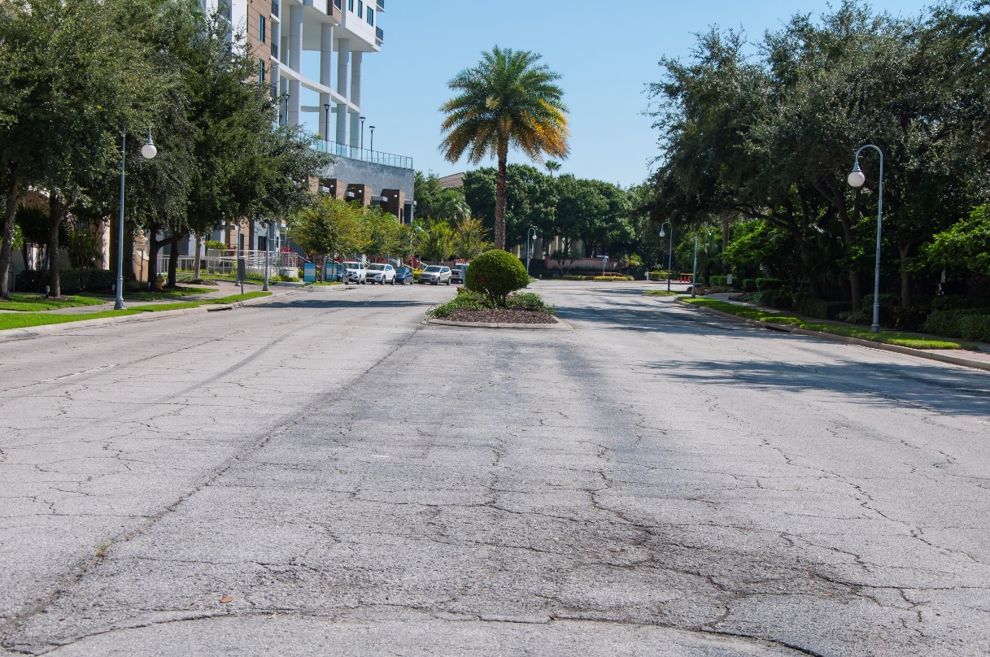
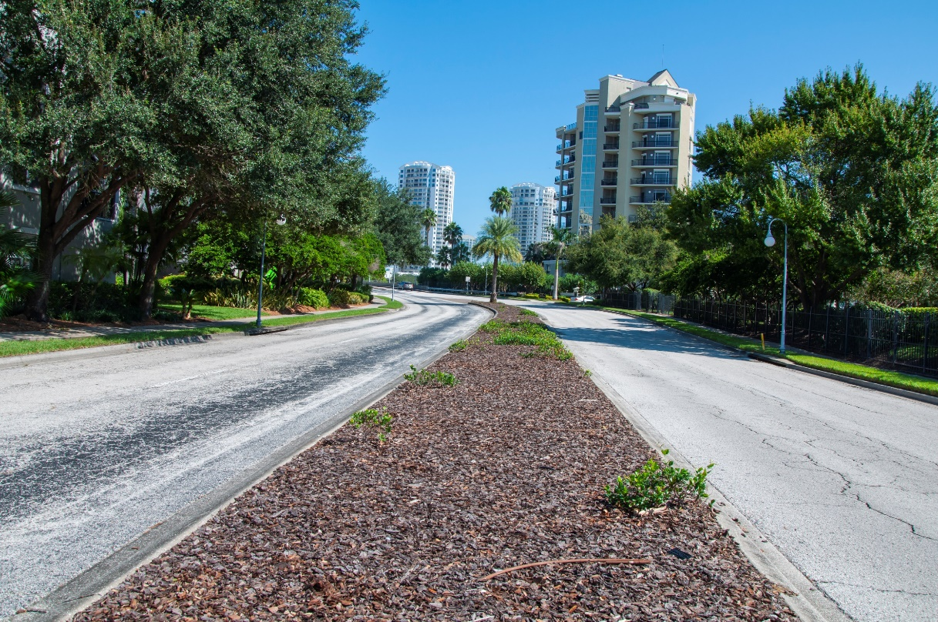
EXISTING PAVEMENT CONDITIONS
Knights Run Ave
Beneficial Dr
Traffic Volumes:
  Beneficial Dr. (2015)= 16,560 AADT
    (2010)= 5,238
  Knights Run Ave. (2015)= 10,500-15,389 AADT

Slide 23

PROJECT INITIATION & BACKGROUND
The City has received many requests to provide traffic calming on the island and improve pedestrian and bike safety.
Speed Table
Median Island

Slide 24
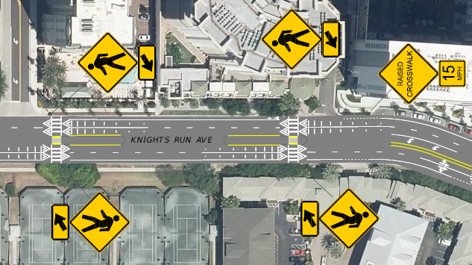
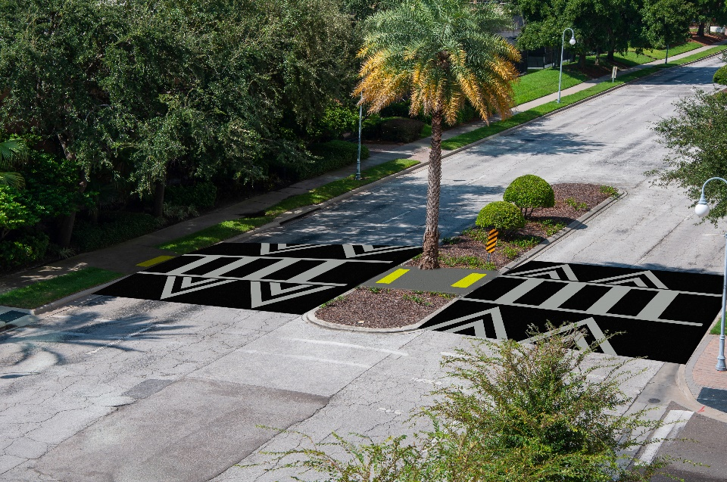
TRAFFIC CALMING & COMPLETE STREETS
PROPOSED IMPROVEMENTS
Raised Pedestrian Crossings, enhancing pedestrian safety
Narrowing travel lanes to ten (10) feet
Lowering Posted Speed Limit
Bicycle Facilities – Installing bike lanes
On Beneficial Bridge – Installing bike lanes and adding a 2-ft buffer to the proposed bike lane

Slide 25
PUBLIC INVOLVEMENT
Provided concept plans at the public meeting held on October 2, 2018.
Provided Raised Pedestrian Crosswalk layout, locations and design
Provided 60% plans at the public meeting held on October 2, 2018.

Slide 26
GENERAL CONCERNS FROM THE MEETING
Public Meeting held October 2, 2018 Tampa Bay History Center.
Below are some of the comments that were received from the public:
Vehicles emerging from Beneficial Bridge travel at a high rate of speed and within the Beneficial corridor. Could an additional raised crossing be added on Beneficial Dr. south of the bridge?
Can a physical barrier between vehicular lanes and bike/pedestrian facilities be added on Beneficial Bridge?
Could fencing or railing be installed to deter pedestrians from crossing south of Channelside Dr from the Riverwalk and Tampa Bay History Center to Garrison Street Parking Lot?
Can the speed limit be lowered?

Slide 27
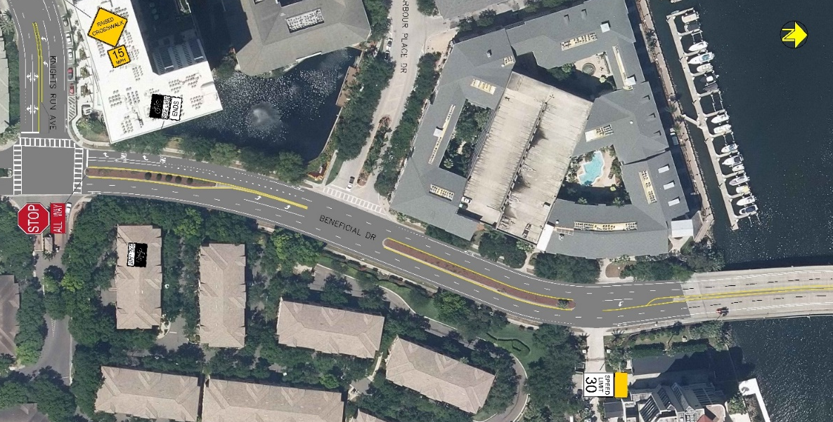
ADDITIONAL CROSSINGS/CALMING ON BENEFICIAL DR
Public Comments:
Cars speeding over the bridge make left turns difficult.
Many pedestrians cross here.
People speed on Beneficial Dr.

Slide 28
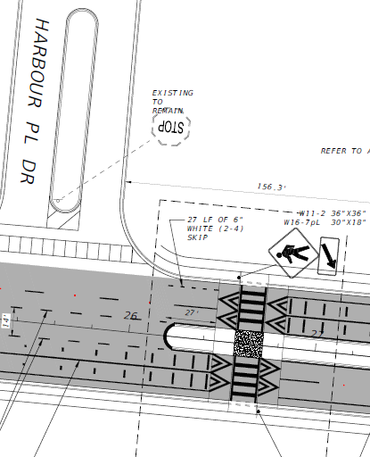
ADDITIONAL CROSSINGS/CALMING ON BENEFICIAL DR
Response:
The City evaluated the two crossing locations, shown on the right
The northern location, shown here in red, did not meet approach sight distance requirements. In other words, vehicles approaching the crosswalk would not have clear sight of the crosswalk and would not have enough time to react to a pedestrian in the crosswalk.
The southern location did meet the sight requirements. The City is proposing a raised crosswalk at this location.

Slide 29
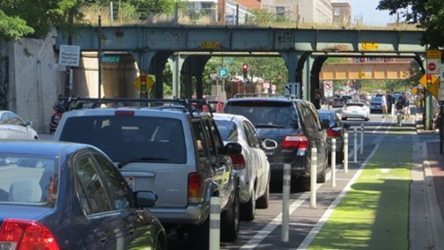
PHYSICAL BARRIER ON THE BRIDGE
Public Comment:
Can a physical barrier between vehicular lanes and bike/pedestrian facilities be added on Beneficial Bridge?
Response:
Unfortunately, there is insufficient width to provide a concrete barrier and maintain two vehicular lanes in each direction. That said, the City is currently planning a pilot project to test a new type of tubular delineator. These delineators are not as substantial as concrete barrier, but they have been shown to increase the “shy distance” of passing vehicles. The City will add this bridge to the list of pilot locations.

Slide 30
PEDESTRIAN RAILING
Public Comment:
Could fencing or railing be installed to deter pedestrians from crossing south of Channelside Dr from the Riverwalk and Tampa Bay History Center to Garrison Street Parking Lot?
Response:
The City recognizes the issue. However, considering the rapidly changing nature of the district, the City would like to coordinate more with the CRA and City Planning officials before adding any railing. Therefore, the City is not proposing any railing with this project but will continue to monitor the location.

Slide 31
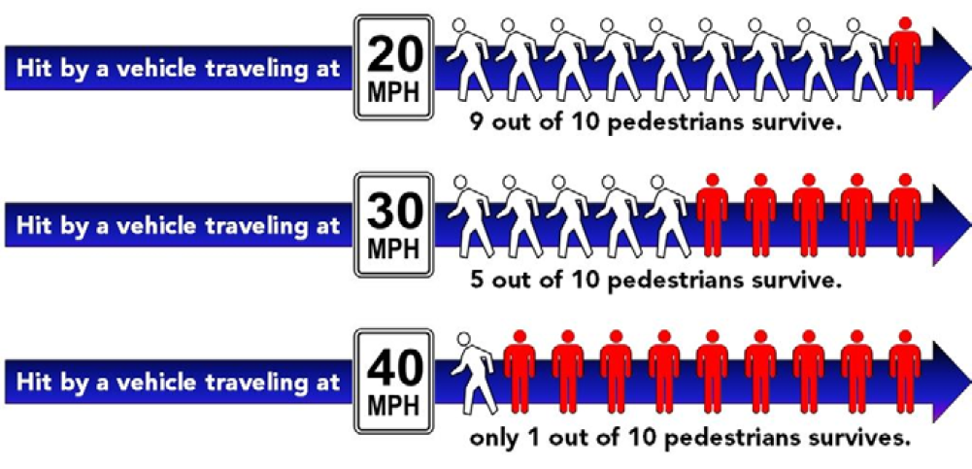

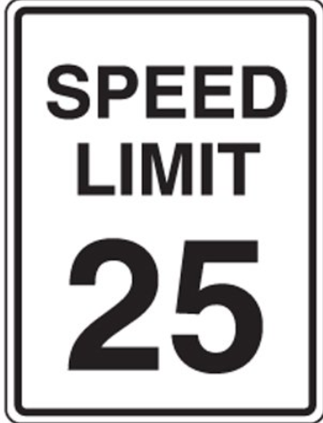
LOWER SPEED LIMITS
Public Comment:
Can the speed limits be lowered?
Response:
Considering the surrounding context and the proposed design changes, it is appropriate to lower the speed limits of both Beneficial Dr. and Knights Run Ave. to 25 mph.
Speed Table
Neck-down/Choker
Raised Intersection
REDUCED SPEED SAVES LIVES
Bike Lanes
Raised Ped Crossing
Lane Narrowing
Median Island
Roundabout
Mini-circle
Proposed Speed Limit Reduction

Slide 32
DESIGN AND CONSTRUCTION SCHEDULE
PHASE | FIRM | COST | FUNDING SOURCE | SCHEDULE
 |  |  |  | START | FINISH
Design | In-House (City of Tampa Staff) | N/A | Complete Streets | Spring 2018 | Fall 2019
Construction | TBD | Est. $351,000 | Complete Streets | Summer 2020* | Fall 2020*
* Construction will commence following the Harbour Island Force Main Replacement Project and continue for approximately four months.

Slide 33
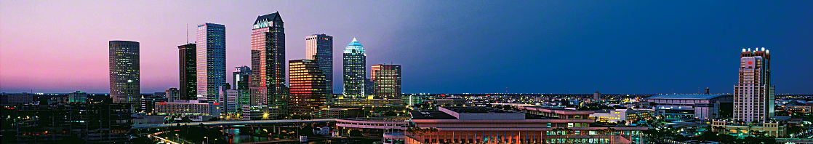
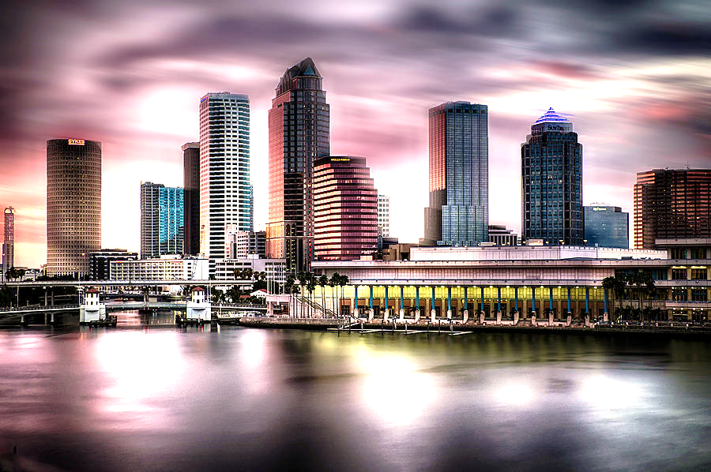
CONTACT INFORMATION
PLEASE PROVIDE EMAIL ADDRESS TO BE PUT ON OUR PROJECT SPECIFIC MAILING LIST
Project Manager – Bernadette Corey
Bernadette.corey@tampagov.net
P: (813) 274-8512
Project Website:
https://www.tampagov.net/tss-transportation/projects/hicompletestreets

Slide 34
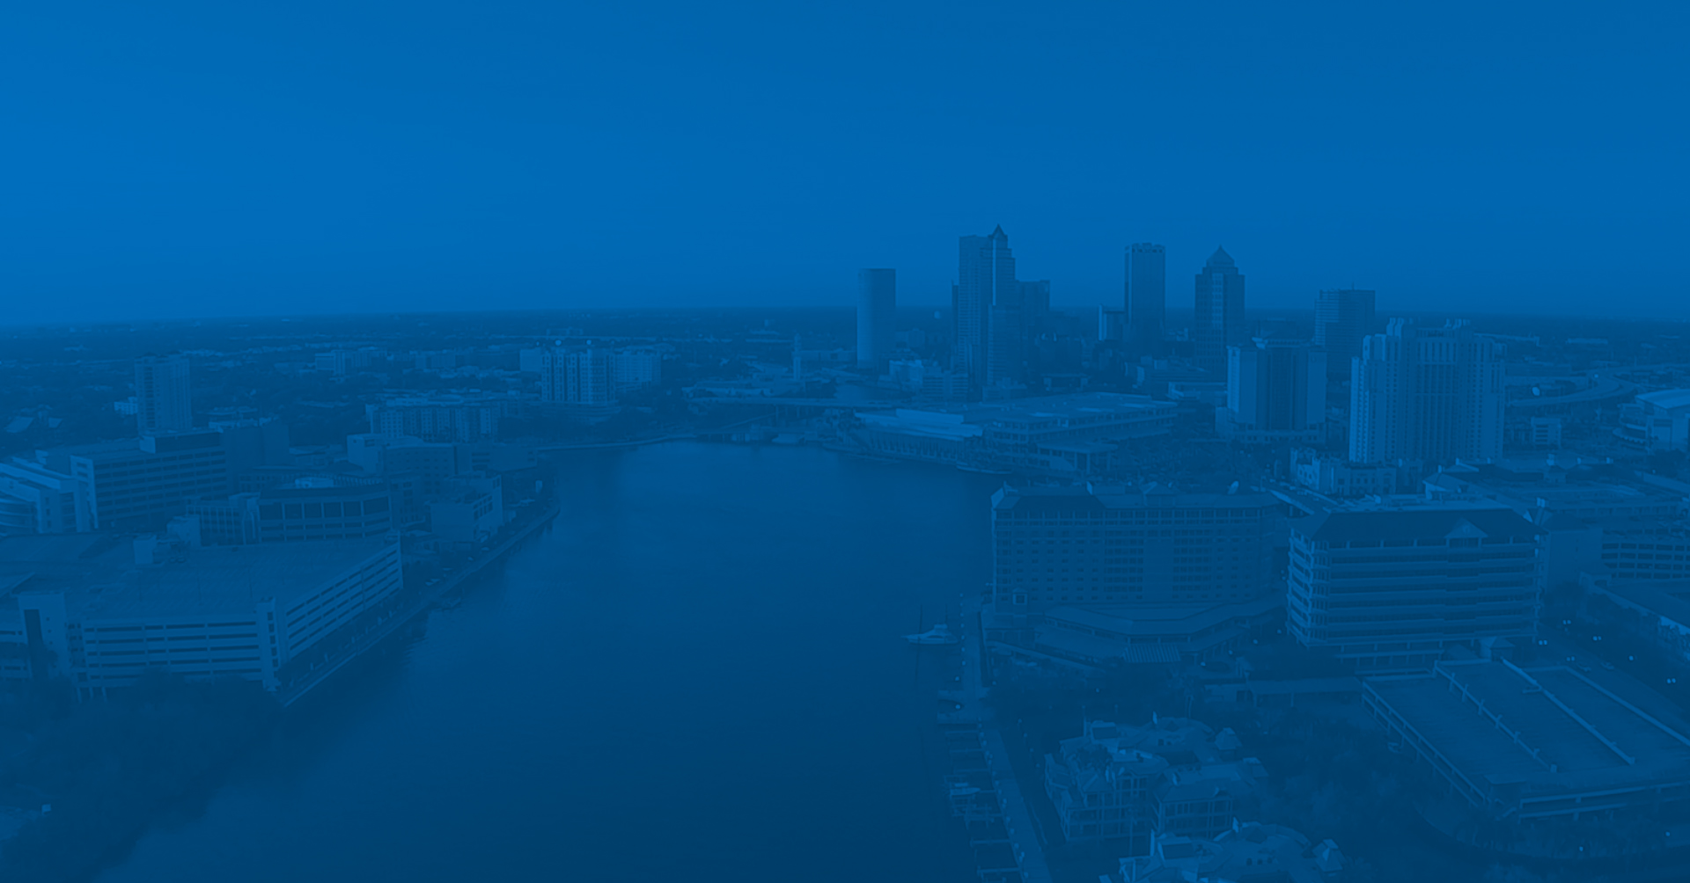
Q & A
Notes:
I’ll open it up for questions.

