Slide 1
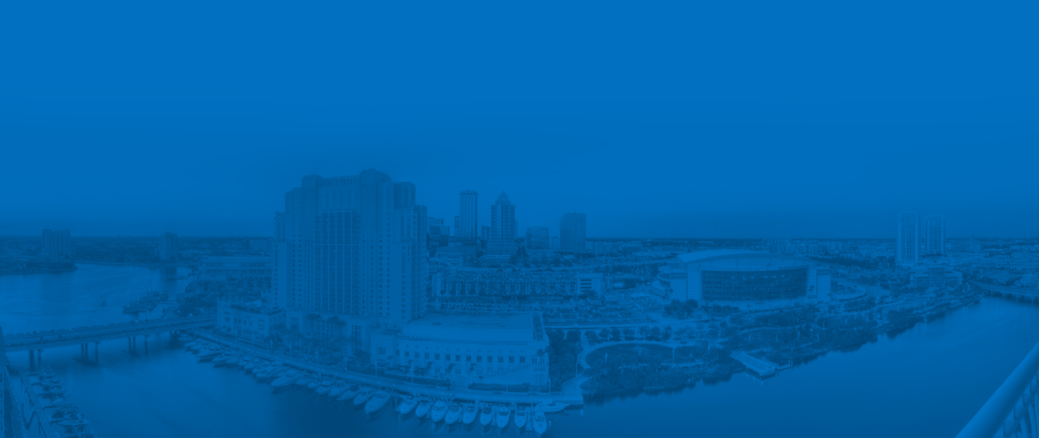

Harbour Island Force Main Replacement
Design – Build Project
Public Meeting
March 26, 2019

Slide 2

Agenda
Project Update
  Preferred 48”/54” Force Main Route
  Status of Easements
  Proposed 12” Force Main Route
  Pipeline Investigation Results
  Upcoming Road Impacts/Closures
Timeline and Coordination
Water St. Construction and Other Future Work
Questions

Slide 3
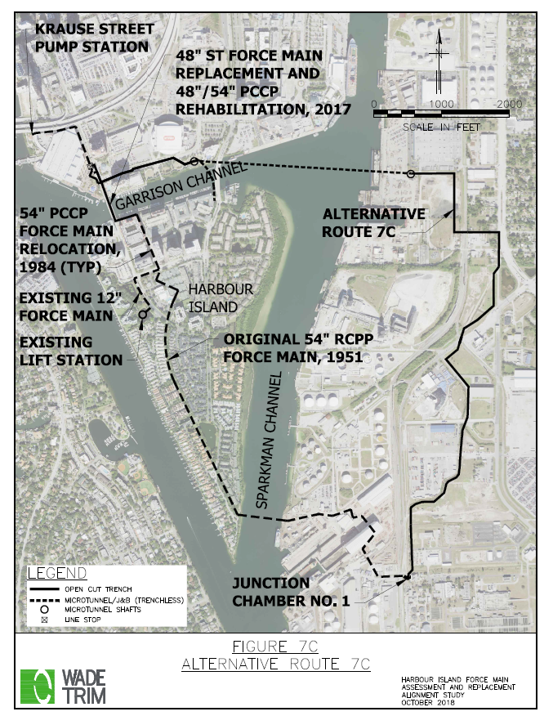
Preferred 48”/54”
Force Main Route

Slide 4
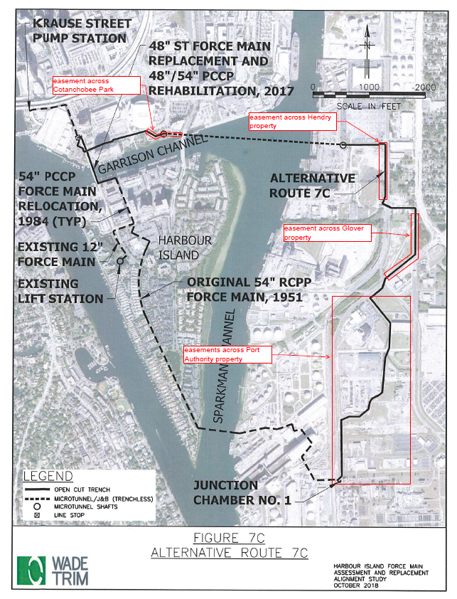
Status of Easements
APPROVAL:
  Port Easement
STILL AWAITING APPROVAL:
  Hendry and Glover properties are agreeable to the easements and appraisals are in the process of being performed
  Easement across Cotanchobee Park requires approval by Florida Communities Trust – the request is under consideration

Slide 5
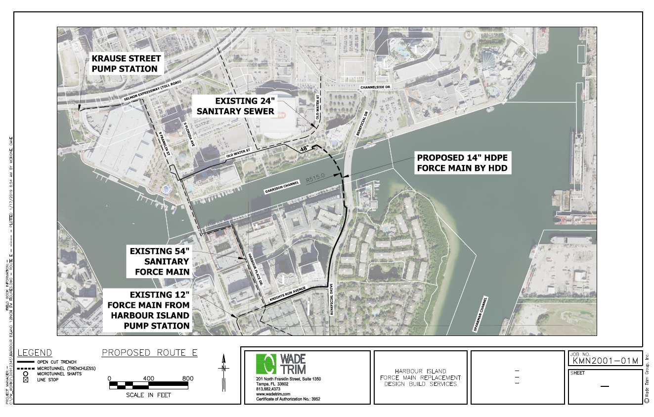
Proposed 12” Force Main Route

Slide 6
Coordination of 12” Force Main
With Transportation Project
Installation of 12-inch force main will be coordinated with upcoming complete streets project on Knights Run Avenue and Beneficial Drive
City is expediting design and construction of 12-inch force main
Construction estimated to start in early 2020

Slide 7
Pipeline Investigation Results
Pipeline Investigation on Franklin St. at Convention Center was completed in early January and results show sections where the internal coating has deteriorated
Approximately 600-ft of pipe requires rehabilitation by carbon fiber lining of the interior.

Slide 8
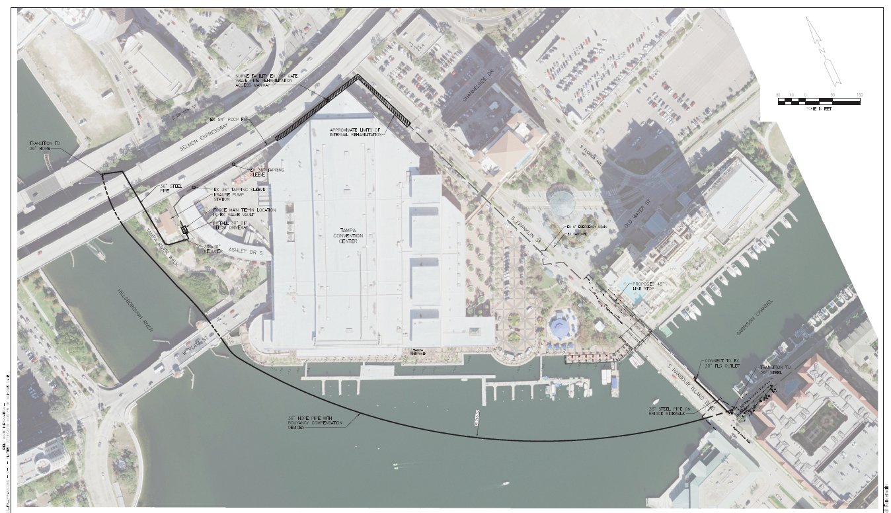
Pipeline Rehabilitation & By-pass Installation
Plan of Action
  Approximately 600 linear feet of line will need to be rehabilitated with carbon lining
  Will require the installation of a bypass system
  Work to start in March and be completed in July 2019.

Slide 9
Pipeline Rehabilitation/By-Pass Impacts to Harbour Island Bridge
By-pass piping will need to be installed on the Harbour Island Bridge along the east side sidewalk. Work to start in mid to late April.
Installation of piping will require temporary closure of the east side sidewalk and the north bound lane during off peak hours for the durations noted below:
    South Connection Point: 2 days
    Bypass Piping: 10 days
    Reset Linestop 3 days
The sidewalk on the east side of the bridge and the north bound lanes will remain open after installation and during rehabilitation work.
After completion of rehabilitation work (estimated in late June), by-pass piping will be removed which will impact the north bound lane during off-peak hours. Duration will be coordinated closer to start date.

Slide 10
Additional Impacts
Franklin Street
  Pipeline rehabilitation work will require the shortening of the south bound left turn lane north of Water Street to facilitate required safety measures.
Air Release Value (ARV) Installation
  Work will occur during the pipeline rehabilitation and will require excavation in the south bound travel lanes on Franklin Street north of Platt Street
  Excavation will require closure of south bound lanes of Franklin Street. Closure will occur over a two night period on non-event nights.
  Road will be re-opened by 7:00am each day.

Slide 11
Timeline for Harbour Island Force Main
Final Route recommendations to the City by May 2019
First Segment of Harbour Island Force Main Installation (along Water Street) began in mid-December 2018. Scheduled to be completed by August 2019
  All work will stop from April 28, 2019 until Tampa Bay Lightning season concludes
Proposed 12” Force Main
  Design scope and approval of contract amendment in progress
  Design and development of construction contract estimated to be completed by October-November 2019.
  Construction will likely start in early 2020 and will last approximately 3-4 months
Final 48”/54” Force Main route design
  Design scope and contract amendment to be developed after approval of route selection
  Design will take approximately 1 year

Slide 12
Water Street Construction and Other Future Work
Old Water Street
  No later than 4/8/19, we will reopen Old Water from Franklin to Florida Avenue north and southbound movement on Florida Avenue will be open.
  We will shut down all eastbound movement on Old Water from Florida Avenue from 4/8/19 – 4/29/19.
  One westbound lane will remain open until 4/8/19 and then the roadway will be closed from Florida to Morgan in all directions.
  All work will cease on 4/29/19 and all roadways open until mid-June.
TECO Manhole/Conduit Relocation on Beneficial Drive
  Work to begin in mid-April
  Will require the closure of one south bound lane on Beneficial from Channelside to the Tampa Bay History Center
  Work will conclude at the end of July 2019
Franklin Street at Old Water Street for New Crosswalk work
SPP Roadway Improvements on Old Water Street and Franklin Street
  Work to begin Summer 2019
  MOT Plans not finalized – but road closures will occur

Slide 13
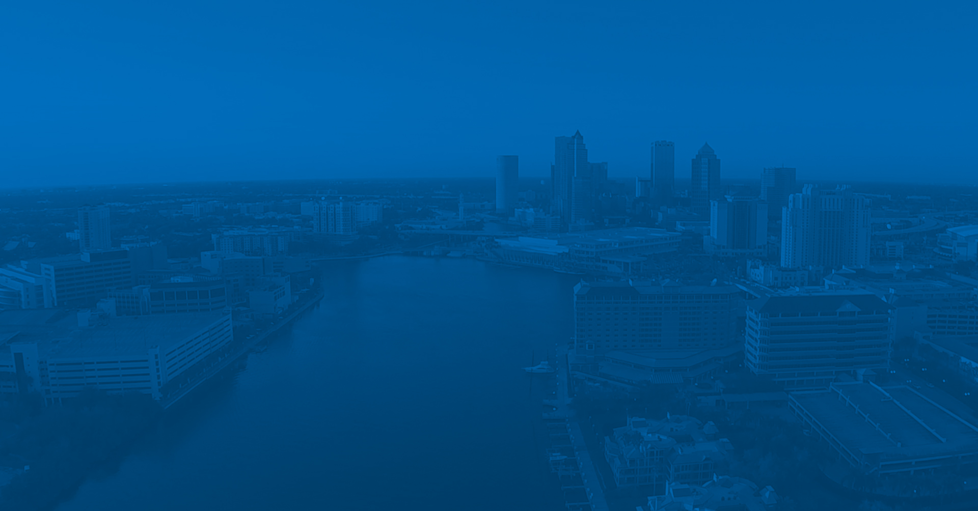
Q & A
Project Website: www.hiforcemain.com
Project Hotline: (813) 235-4830
Notes:
I’ll open it up for questions.

